Slide 1
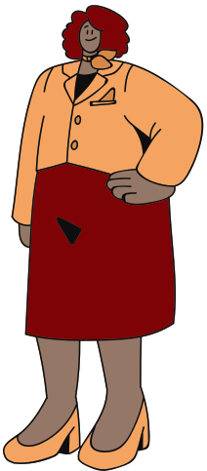

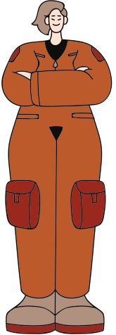

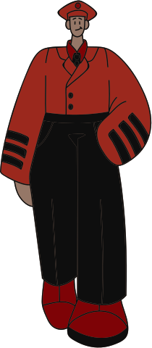
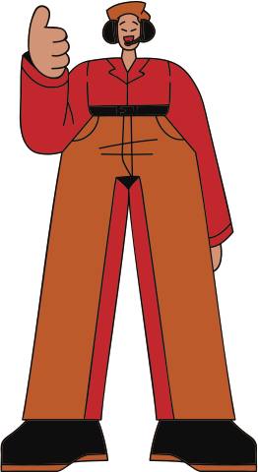
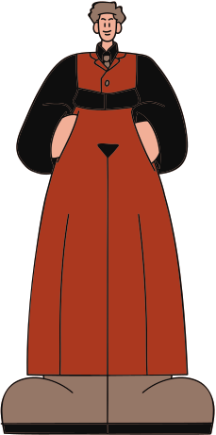

South Valley Junior High
WHAT IS ADVISORY?
STUDENT INFORMATION & EXPECTATIONS

Slide 2
ADVISORY GOALS
To grow the whole student by expanding skills as both people and students.

Slide 3
ADVISORY PURPOSE
To build a campus culture that supports all students and their success in their academics, growth mindset, and personal goals.

Slide 4
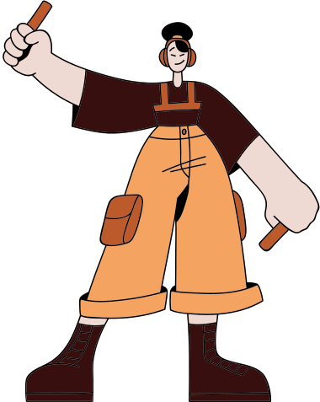
HOW WILL WE DO THIS?
  Campus-wide lessons every Monday.
  Intervention days Tuesdays & Thursdays.
  Attendance & Grade checks Fridays.
  Student Planners.
  Sabercat Celebrations

Slide 5
LESSONS & ACTIVITIES
3 areas of focus:
Team Building
Skill Building
Housekeeping
Activities that will help you build connections with your Advisory class.
  Growth Mindset,
  Digital Citizenship,
  Academics
Information that all students need to know from the school.

Slide 6
WEEKLY SCHEDULE
Mondays
Tuesdays & Thursdays
Fridays
  Help from specific teachers,
  Missing Work,
  Homework,
  Reading.
  Attendance Check
  Grade Check
  Sabercat Celebrations
Campus Wide Lessons

Slide 7

MONDAYS
  Lessons will be posted in the Google Classroom.
  Students will complete the Google Form reflection after each lesson.
  Students will not leave their assigned "home base" advisory room.

Slide 8

TUESDAYS & THURSDAYS
  Leaving the Classroom:
    Starts Aug 15
    Students must be invited by a teacher who has signed their advisory pass.
    You stay in the new classroom for the entire advisory period.

Slide 9

TUESDAYS & THURSDAYS
  Staying in the "home base," students may:
    Work on missing work.
    Work on homework.
    Read

Slide 10
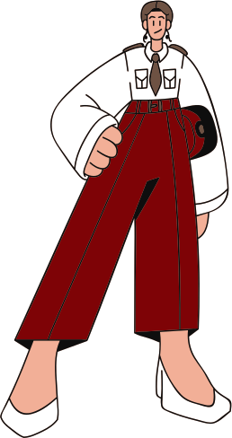
FRIDAYS
  Login to Infinite Campus:
    Check attendance
    Check grades
    Check missing work
    Record in your planner
  Make a plan for completing work
  Students will not leave their assigned "home base" advisory room.

Slide 11
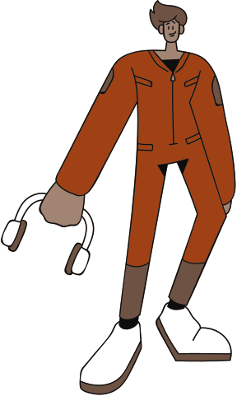
FRIDAYS
  Sabercat Celebrations:
    Best attendance
    Monthly contests
    Spirit week participation

Slide 12
ADVISORY IS...
Academic intervention time
Time to connect with your teacher & classmates
Time to check-in on your academic progress
Time to get important information from the school.

Slide 13
ADVISORY IS NOT...
Free Time
Phone Time
Game Time

Slide 14
STUDENT EXPECTATIONS

Slide 15
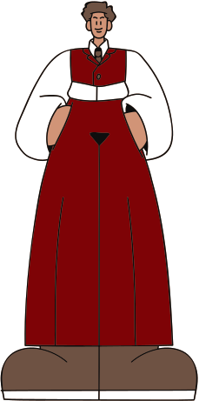
BE RESPECTFUL
  Check a negative attitude at the door.
  Listen to announcements by being silent.
  Listen when classmates are speaking.
  Listen when the teacher is giving instructions or presenting a lesson.
  Respect others' opinions.

Slide 16
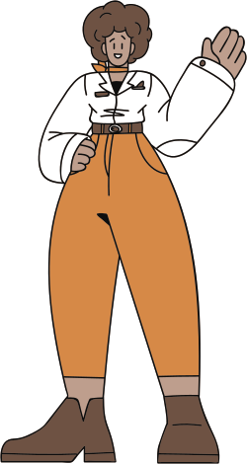
BE PREPARED
  Check with your teachers before advisory if you need to attend their class for extra help.
  Have all materials ready to work on missing work or homework.
  Have a book to read if you have no missing work.

Slide 17
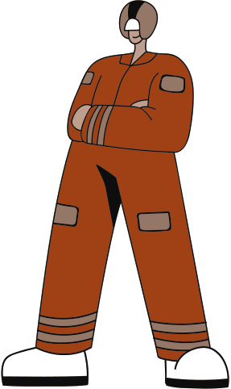
PARTICIPATE
  Participate in advisory lessons and complete the reflection form.
  Participate in Sabercat celebration competitions.
  Get to know your teacher and classmates.

Slide 18
THANK YOU!
Please fill out the reflection form linked in the Google Classroom.
Classroom code: i45njth

