Slide 1
Parent Information on Course Selection 2021-2022
Highland High School

Slide 2
Course Selection TimeLine For Current HHS Students
January 11th - 15th: Registration Week
January 14th & 15th: Registration DAY
January 15th - 20th: Counseling Q & A
Student Portal Opens on January 21st
Student must have their course requests entered in IC prior to scheduled advisement date (through their English classes)
January 21 – February 12: Course Advisement with current Freshman, Sophomores, and Juniors

Slide 3
Items needed for Course Selection – Found online only ON… HHS Website
Course Description Book
*Course Description book can also found on the district website www.gilbertschools.net>Academics
Directions on how to input classes into Infinite Campus
PowerPoints
Course Advertisements
Please take time to review the information in the Course Description Book with your child.
Course Listing Form

Slide 4
Gilbert Public Schools
Graduation Requirements
Arizona University
Entrance Requirements
 | Credit(s)
English | 4
Math | 4
Science | 3
Social Studies | 3
Physical Education | 1
Electives | 5
CTE/Fine Arts (any combination) | 2
Total Credits Required Must Meet Standard on mandated state test and the Arizona Civics test.
 | Credit(s)
English | 4
Math (through Pre-Calculus or the equivalent) | 4
Science | 3
Social Studies | 2
World Languages (2 years of the same language) | 2
Fine Arts /CTE | 1
Total Credits Required | 16
22

Slide 5
What are Fine ART/ CTE Credits?
Fine Art classes include:
Performing Arts
Visual
Dance
CTE classes include:
Agriculture, Business, Family & Consumer Sciences, Industrial Ed, and EVIT.
A 4th year in Student Council, AVID, Spanish IV, or Sports Training may substitute for one credit of the CTE/Fine Art requirement.

Slide 6
A Typical Freshman Schedule
English: English I or Honors English I
Math: Algebra or Honors Alg., Geometry or Honors Geom.
Science: Lab Biology or Honors Lab Biology, Earth Science
PE
Lunch
Elective (Fine Art, CTE, etc.)
Elective (Music, AG, Modern Language, etc.)

Slide 7
A Typical Sophomore Schedule
English: English II, Honors English II , or Block English (optional two hour block of English/History)
Math: Geometry, Honors Geom., Algebra II or Hon Algebra II
Science: Many options are available through our Science Department or through our Agriculture Department.
Social Studies: World Studies, AP World Studies, Block History
Lunch
Elective or PE
Elective (Please note CTE/Fine Art Requirements)
Note: 10th grade students may not be a student aide
Notes:
*therefore, selecting the electives and alternates are absolutely essential.

Slide 8
A Typical Junior Schedule
English: English III, AP English III or Block English (optional two hour block of English/History)
Math: Algebra II or Honors Algebra II, Intermediate Algebra
Science: Many options are available through our Science Dept. or through our Agriculture Department
Social Studies: American History, AP U.S. History, or Block History
Lunch
Elective or PE
Elective: Please note CTE /Fine Art requirements

Slide 9
A Typical Senior Schedule
Senior English: English IV, English 101/102 or AP English
Government: Government, We the People, or AP Government
Economics: Ag Business & Management, Marketing, Advanced Ag, Economics, Stock Market, AP Macro, Adv. Business, Co-op Learning Classes (work study)
Math: 4 years of math is a graduation requirement. Several math options are available
Elective or Missing Required Course for Graduation
Elective or course needed for post secondary plans
*All students must be enrolled in a minimum of five hours,
regardless of credits needed for graduation.
*If a senior desires release time, a release time form must be signed by parents.

Slide 10
Entering Course Requests (Students will select courses within their academic planner)
STUDENTS MUST ENTER THEIR COURSE REQUESTS VIA INFINITE CAMPUS STUDENT PORTAL
The Infinite Campus Portal will be available to all current HHS students beginning January 14th.
Student Deadline to Enter Courses in IC: Advisement with all grade levels:
On the HHS website>Counseling tab, you will find written instructions demonstrating the data entry.
January 20 Jan 21- Feb 12

Slide 11
Course Selection
You will choose the courses you want to take and enter them into your Academic planner.
Academic Planning 2021-2022: Let’s get started!
Log into your Infinite Campus account
Click on “Academic Plan”
Select “Post Graduation Location”
Select “Post Grad Plans”
Select “Next”
Go to the grade level you are registering for and enter course selections

Slide 14
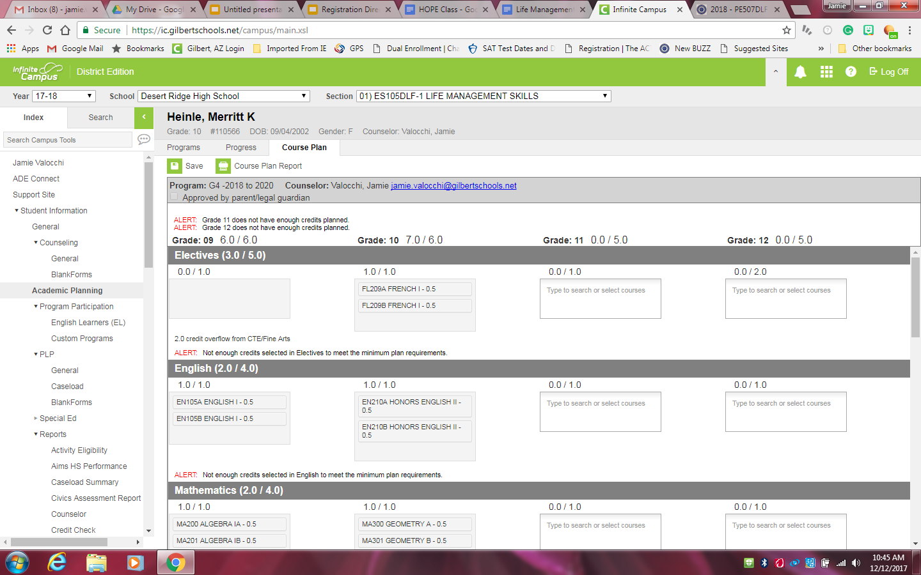
Start Entering Your Courses for Next Year
Go to the grade level you are registering for
Click on the blank box in each subject area and choose the class you want from the drop down menu.
If it’s a full year course, make sure you choose A (for 1st semester) and B (for 2nd semester)
Click here to select a class

Slide 15
Things to remember
Please fill in at least 3 alternates. Alternate courses are used in the event that your requested courses are not available.
You need to select 6 classes for a full schedule, 7 if you are planning to take A-hour
Any courses over 6 will have a $180 fee per class, per semester.
DO NOT enter any course you plan to take in Summer School or Online

Slide 16
Online learning Guidelines
Registration is done through the Counseling Office. Forms are available in the front office.
Please be aware that online, distance learning courses may NOT meet NCAA eligibility requirements.
Any additional class after six will have a fee of $160.00 per class, per semester.
Outside Online Providers
Students taking courses through an outside provider will have to take and pass our final with a 60% for core classes or it will be an elective credit.

Slide 17
2021 IN-PERSON Summer School
WHEN
June 7 – June 18 (Session 1)
July 21 – July 2 (Session 2)
Monday – Friday 7:15am – 12:45pm (no afternoon sessions)
WHERE
Gilbert High School
Transportation details coming soon
REGISTRATION
Registration begins during credit checks and ends May 27th
Registration forms will be available in the counseling office

Slide 18
NCAA – Potential Athlete
If your son or daughter is hoping to be a student athlete in college, there are many requirements that must be met to qualify through the NCAA Eligibility Clearinghouse.
1
Check out NCAA Eligibility Center for details and information. www.ncaaclearinghouse.net
2

